Slide 1


<Name>
<Date>

Slide 2

Outline
Executive Summary
Introduction
Methodology
Results
Conclusion
Appendix

Slide 3
Executive Summary
Summary of methodologies
Data collection via API, Web scrapping
Exploratory DATA Analysis (EDA) with Data visualization
EDA with SQL
Interactive Map with Folium
Dashboards with Plotly Dash
Predictive Analysis
Summary of all results
Exploratory Data Analysis
Interactive maps and dashboard
Predictive results

Slide 4
Introduction
Project background and context
Our aim is to predict successful landings of Space X’s Falcon 9 rocket. This results in more efficient space exploration modules which can be reused, reducing the cost of this endeavor
Problems you want to find answers
What are the main characteristics of successful landings
What features affect a successful or a failed landing?
Can we predict when a landing will be successful?
What conditions allow SpaceX to achieve higher success rates?

Slide 5

Section 1

Slide 6
Accuracy of Logistic Regression: 0.8333333333333334 Accuracy of Support Vector Machine: 0.8333333333333334 Accuracy of Decision Tree: 0.8333333333333334 Accuracy of K-Nearest Neighbors: 0.8333333333333334
Accuracy of Logistic Regression: 0.8333333333333334 Accuracy of Support Vector Machine: 0.8333333333333334 Accuracy of Decision Tree: 0.8333333333333334 Accuracy of K-Nearest Neighbors: 0.8333333333333334
Methodology
Executive Summary
Data collection methodology:
SpaceX REST API
Web Scraping from Wikipedia
Perform data wrangling
Dropping unnecessary columns
One-hot encoding for classification models
Perform exploratory data analysis (EDA) using visualization and SQL
Perform interactive visual analytics using Folium and Plotly Dash
Perform predictive analysis using classification models
Built Logistic Regression, SVM, Decision tree and KNN models to predict Falcon 9 successful landings with tuning hyperparameters

Slide 7
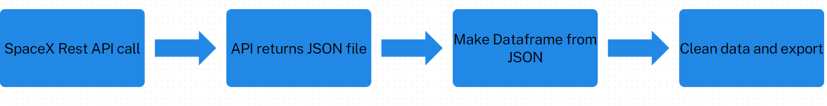
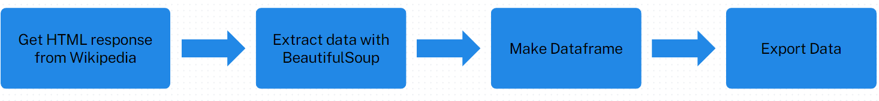
Data Collection
Data sets collected from REST SPACEX API and web scrapping Wikipedia
SpaceX Rest API URL is api.spacexdata.com/v4
Data sets were collected web scrapping Wikipedia (updated 06/2021):
URL:https://en.wikipedia.org/w/index.php?title=List_of_Falcon_9_and_Falcon_Heavy_launches&oldid=1027686922

Slide 8
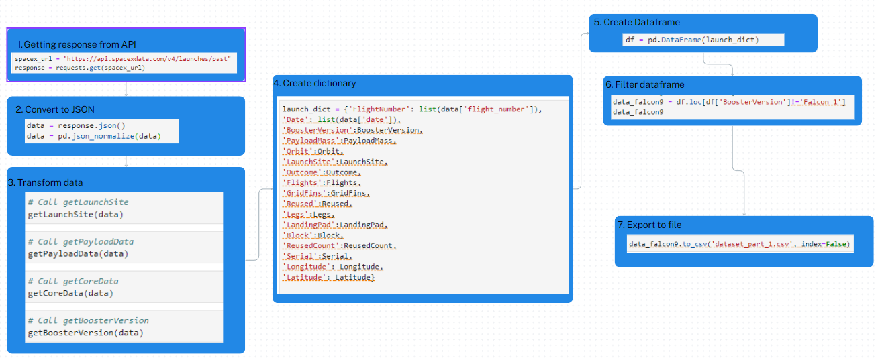
Data Collection – SpaceX API

Slide 9
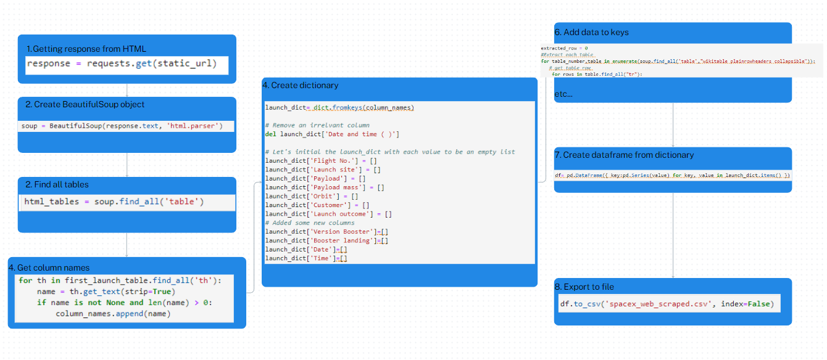
Data Collection - Scraping

Slide 10
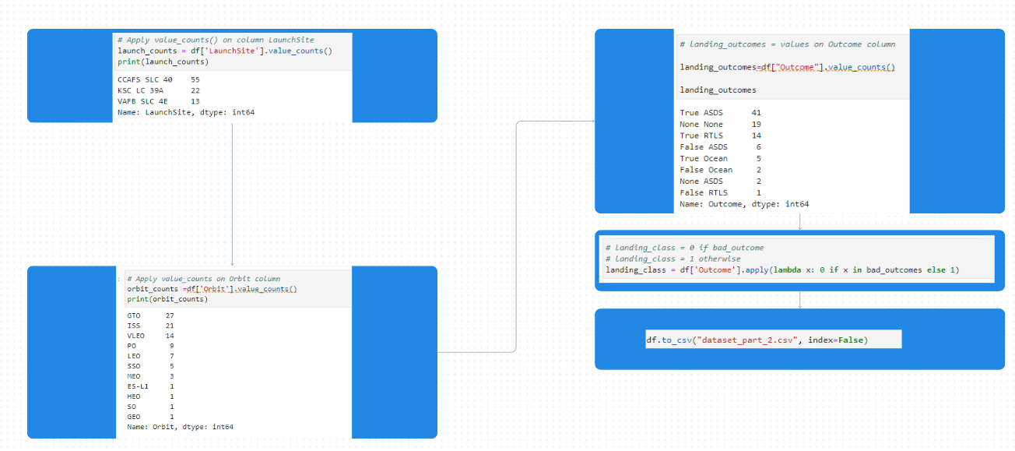
Data Wrangling
There are cases where booster did not land successfully:
TrueOcean, TrueRTLS, TrueASDS means the mission has been successful
False Ocean, False RTLS, False ASDS means the mission was a failure
Transform string variables into categorical variables where 1 means the mission has been successful and 0 means the mission was a failure.

Slide 11
EDA with Data Visualization
Scatter Graphs: show relationship between variables (i.e. correlation)
Flight Number vs. Payload Mass
Flight Number vs. Launch Site
Payload vs. Launch Site
Orbit vs. Flight Number
Payload vs. Orbit Type
Orbit vs. Payload Mass
Bar Graph: show the relationship between numeric and categoric variables
Success rate vs. Orbit.
Line Graph: show data variables and their trends
Success rate vs. Year

Slide 12
EDA with SQL
Performed SQL queries to gather and understand dataset:
Displaying the names of the unique launch sites
Display 5 records where launch sites begin with the string 'CCA’
Display the total payload mass carried by boosters launched by NASA (CRS).
Display average payload mass carried by booster version F9 v1.1.
List the date when the first successful landing outcome in ground pad was achieved.
List the names of the boosters which have success in drone ship and have payload mass greater than 4000 but less than 6000.
List the total number of successful and failure mission outcomes.
List the names of the booster_versions carrying maximum payload mass.
List the records with month names, failure landing_outcomes in drone ship, booster versions, launch_site for the months in year 2015.
Rank successful landing_outcomes between the date 2010 and 2017 in descending order.

Slide 13
Build an Interactive Map with Folium
Folium map object is a map centered on NASA Johnson Space Center at Houston
Red circle at NASA Johnson Space Center's coordinate with label showing its name (folium.Circle, folium.map.Marker).
Red circles at each launch site coordinates with label showing launch site name (folium.Circle, folium.map.Marker, folium.features.DivIcon).
The grouping of points in a cluster to display multiple and different information for the same coordinates (folium.plugins.MarkerCluster).
Markers to show successful and unsuccessful landings. Green for successful landing and Red for unsuccessful landing. (folium.map.Marker, folium.Icon).
Markers to show distance between launch site to key locations (railway, highway, coastway, city) and plot a line between them. (folium.map.Marker, folium.PolyLine, folium.features.DivIcon)

Slide 14
Build a Dashboard with Plotly Dash
Dashboard has dropdown, pie chart, range slider and scatter plot components
Pie chart shows the total success and the total failure for the launch site chosen with the dropdown component (plotly.express.pie).
Range slider allows a user to select a payload mass in a fixed range (dash_core_components.RangeSlider).
Scatter chart shows the relationship between two variables, in particular Success vs Payload Mass (plotly.express.scatter).

Slide 15
Predictive Analysis (Classification)
Preparation
Load data
Normalize
Split into train/test sets
Models:
Used four models: Logistic regression, SVM, decision tree and KNN
Tuned hyperparameters to increase accuracy
Computed accuracy and confusion matrix
Compare
Based on accuracy, selecting best model

Slide 16
Results
Exploratory data analysis results
Interactive analytics demo in screenshots
Predictive analysis results

Slide 17

Section 2

Slide 18
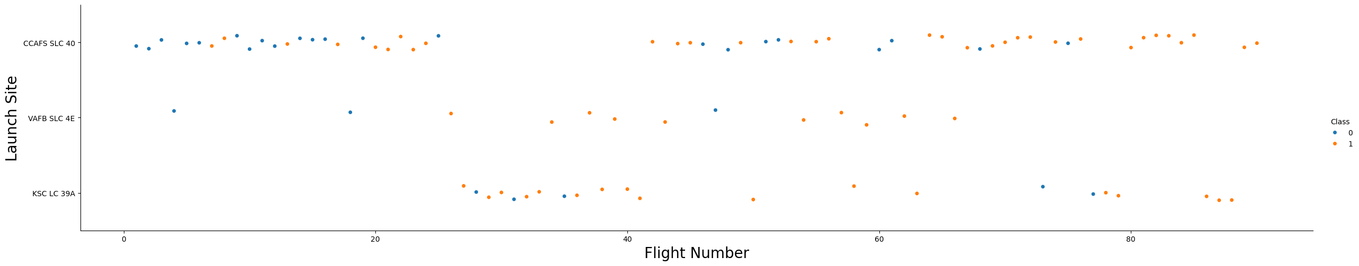
Flight Number vs. Launch Site
In general, the success increases with flight number for each site.
KSL site has some failed flights even at large number

Slide 19
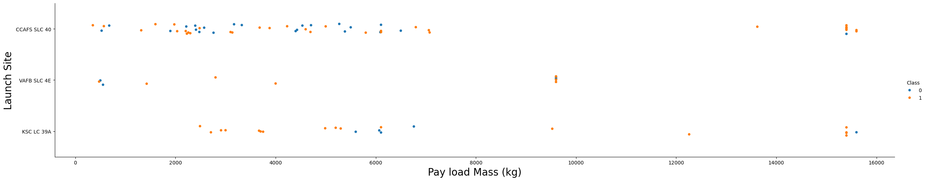
Payload vs. Launch Site
For CCAFS site high payload has more failed landing while for VAFB payload has less effect on landing success

Slide 20
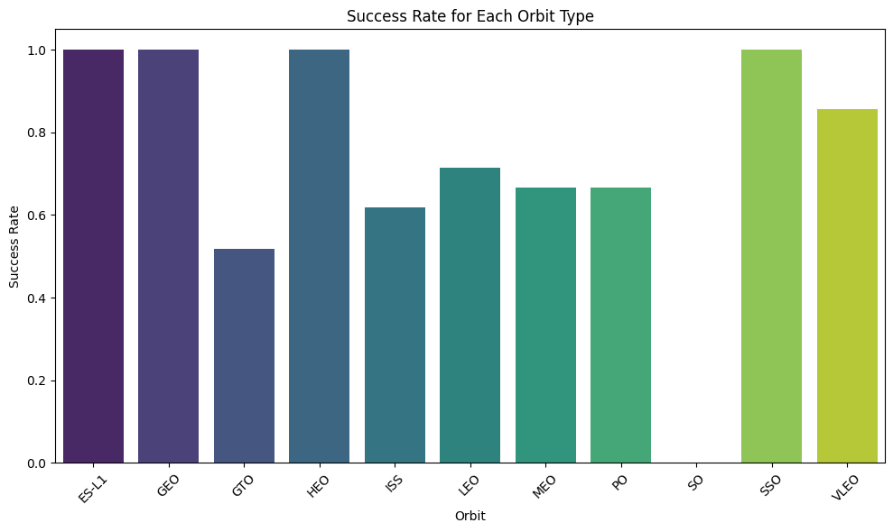
Success Rate vs. Orbit Type
Some orbits have more success rate than others, namely: ES-L1, GEO, HEO and SSO.

Slide 21
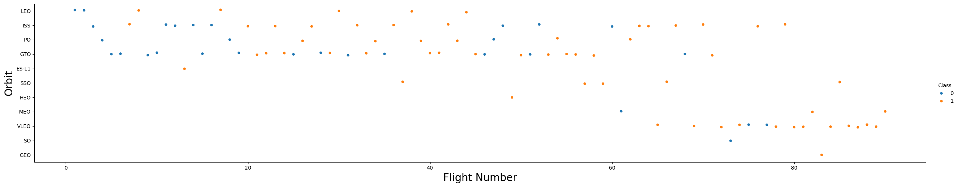
Flight Number vs. Orbit Type
Some of the orbits have increased success with number of orbits. This can explain the former success rates in the previous slide (i.e. more trial and error makes for better landings)

Slide 22
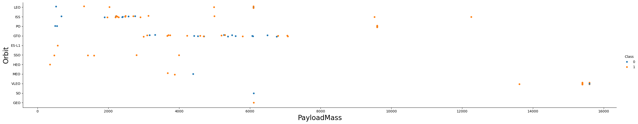
Payload vs. Orbit Type
Some orbits like GTO has more failed landings for heavier payloads than others. However, LEO or PO can sustain higher payloads with lower failures.

Slide 23
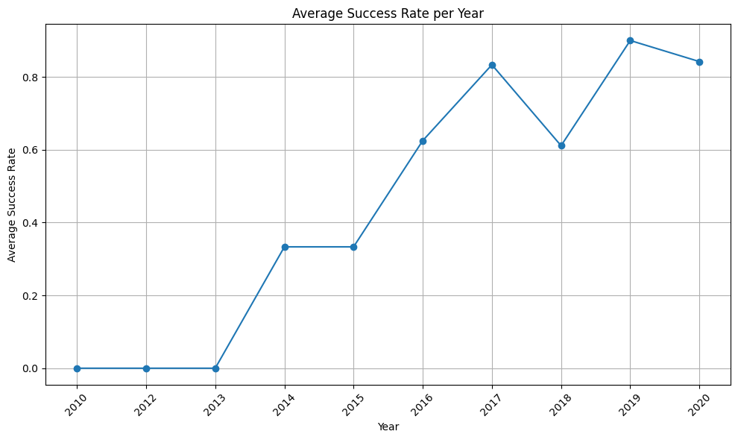
Launch Success Yearly Trend
The success rate increases per year. This can be due to more knowledge on repeating previous successes and preventing previous errors, while better technology.

Slide 24
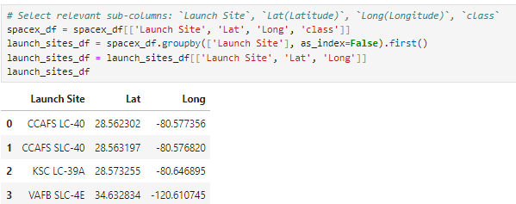
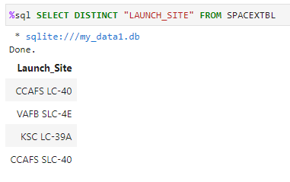
All Launch Site Names
We find the distinct launch sites by using groupby function.
Alternatively we could use SQL query: SELECT DISTINCT “LAUNCH_SITE” FROM SPACEX

Slide 25
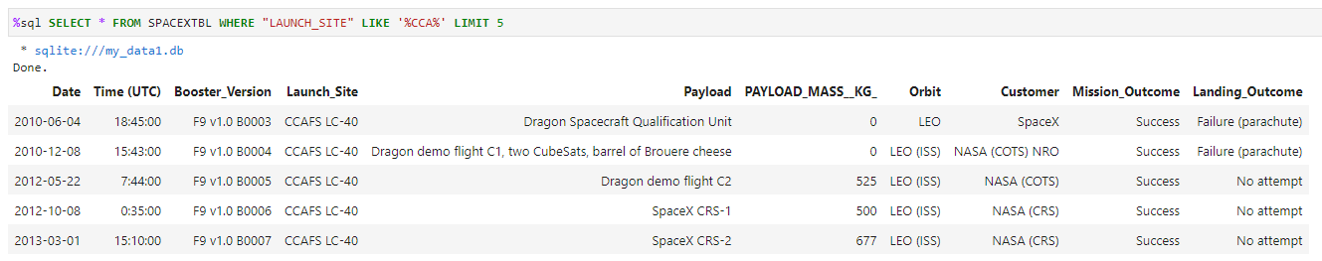
Launch Site Names Begin with 'CCA'
We use the WHERE clause followed by LIKE to constrain the search. Then we use LIMIT to find 5 records

Slide 26
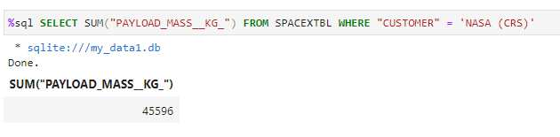
Total Payload Mass
Use SUM on the Payload_Mass column constrained to costumer being NASA (CRS)

Slide 27
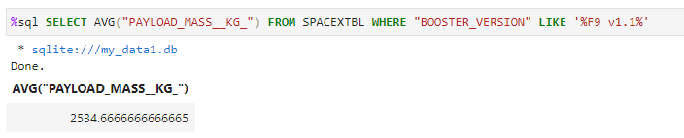
Average Payload Mass by F9 v1.1
Calculate the average of the Payload_Mass column constraining the booster_version type to F9 v1.1

Slide 28
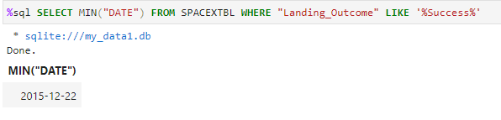
First Successful Ground Landing Date
We find the first date using MIN function where the Landing_Outcome has some Success in its entry

Slide 29
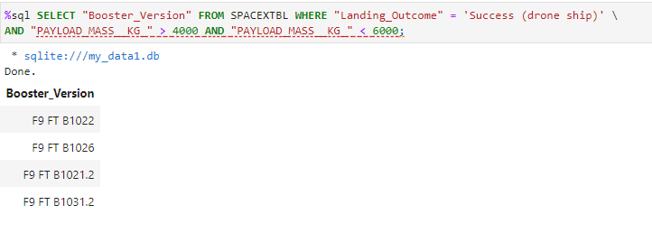
Successful Drone Ship Landing with Payload between 4000 and 6000
We use WHERE to constrain the successful landings where the Payload_Mass entry is between the given boundaries

Slide 30
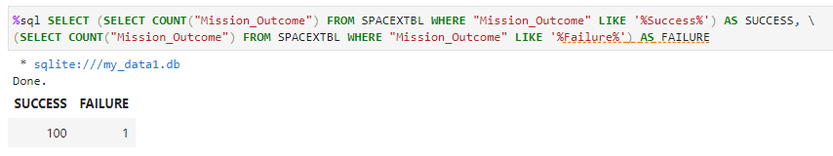
Total Number of Successful and Failure Mission Outcomes
We select the successes and failures and store them under their respective names

Slide 31
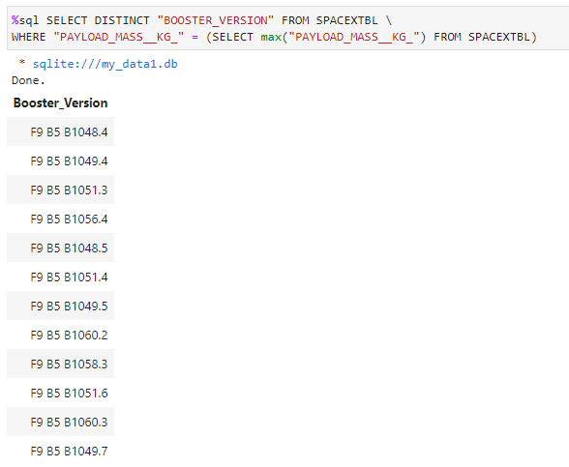
Boosters Carried Maximum Payload
We use the command SELECT DISTINCT to choose the distinct boosters and WHERE to select those carrying payload equal to maximum payload

Slide 32
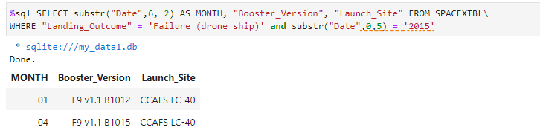
2015 Launch Records
Select those records by displaying the month names, failure landing_outcomes in drone ship, booster version, launch site for the months in 2015

Slide 33
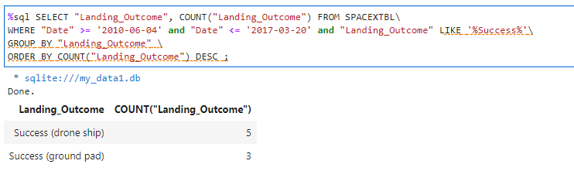
Rank Landing Outcomes Between 2010-06-04 and 2017-03-20
Count from a selection where the landing outcome is success for drone and ground.

Slide 34

Section 3

Slide 35
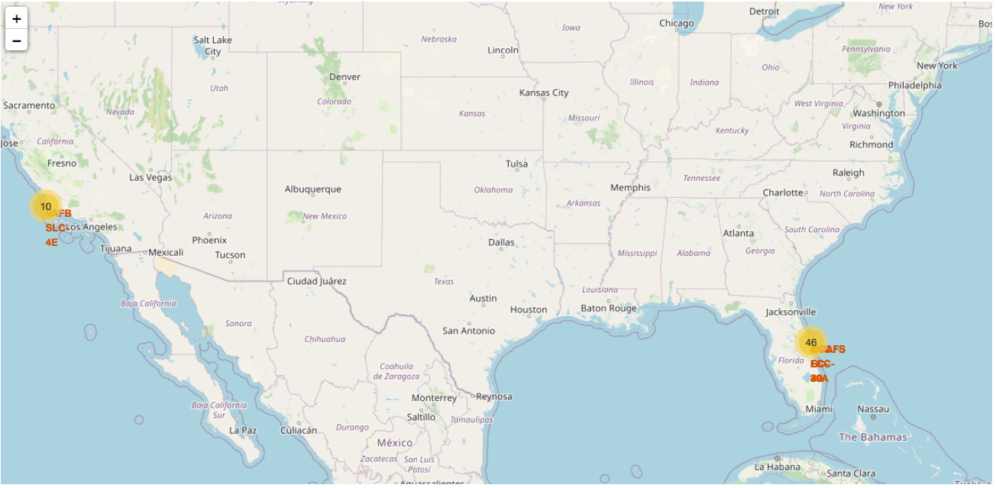
<Folium Map Screenshot 1>
SpaceX locations are on the coast of California and Florida states (USA)

Slide 36
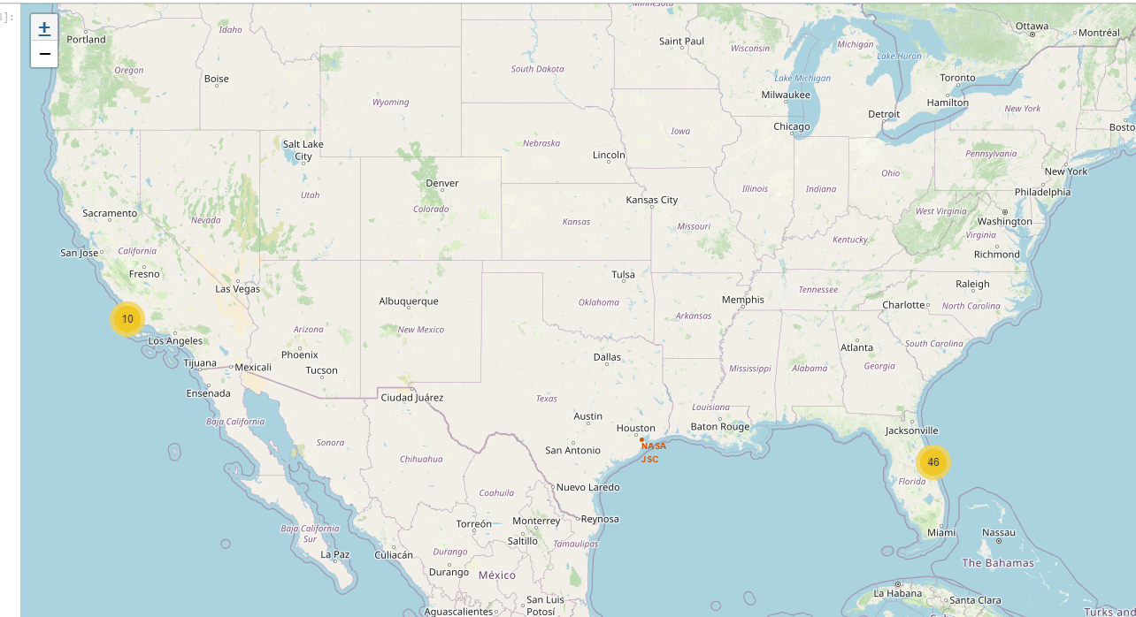
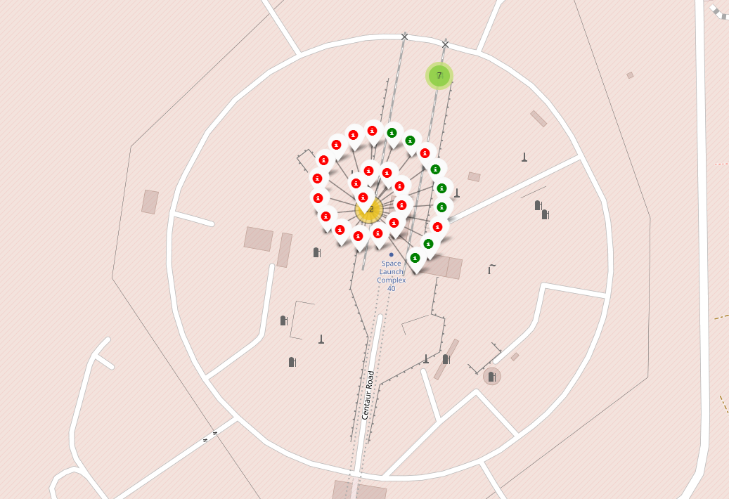
<Folium Map Screenshot 2>
As an example, we show one of the locations with green markers (showing successful landings) and red markers (failed landings).

Slide 37
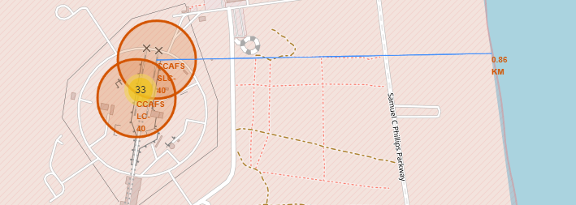
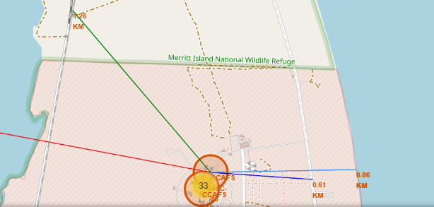
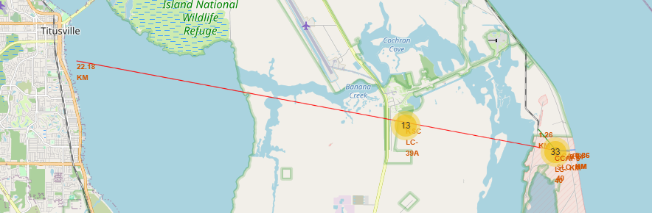
<Folium Map Screenshot 3>
We see how the proximity to coastlines
To roads
To railways
To cities

Slide 38

Section 4

Slide 39
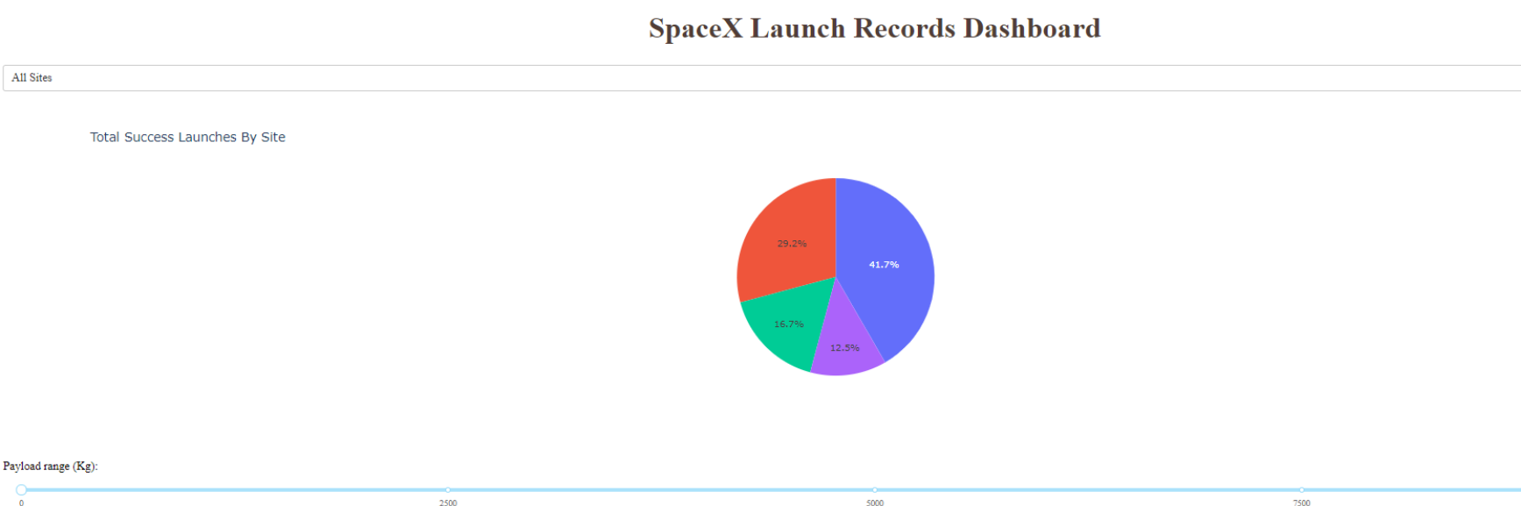
Total Success by site
KSC LC-39A has the largest success rate

Slide 40
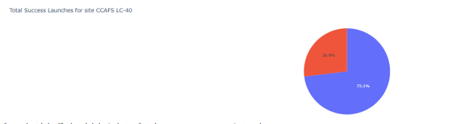
Total success – CCAFS LC-40
CCAFS LC-40 has a success rate of 73.1% and failure rate of 26.1%

Slide 41
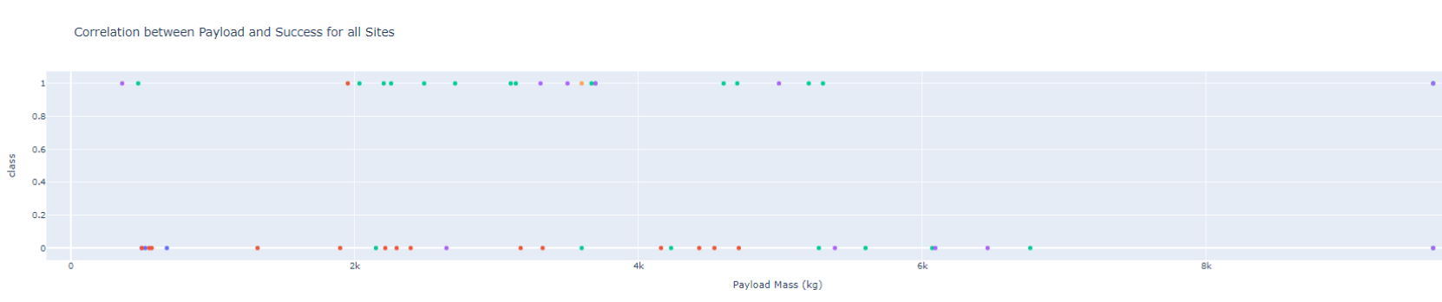
Payload and success
Correlation between payload and success for all sites

Slide 42

Section 5

Slide 43
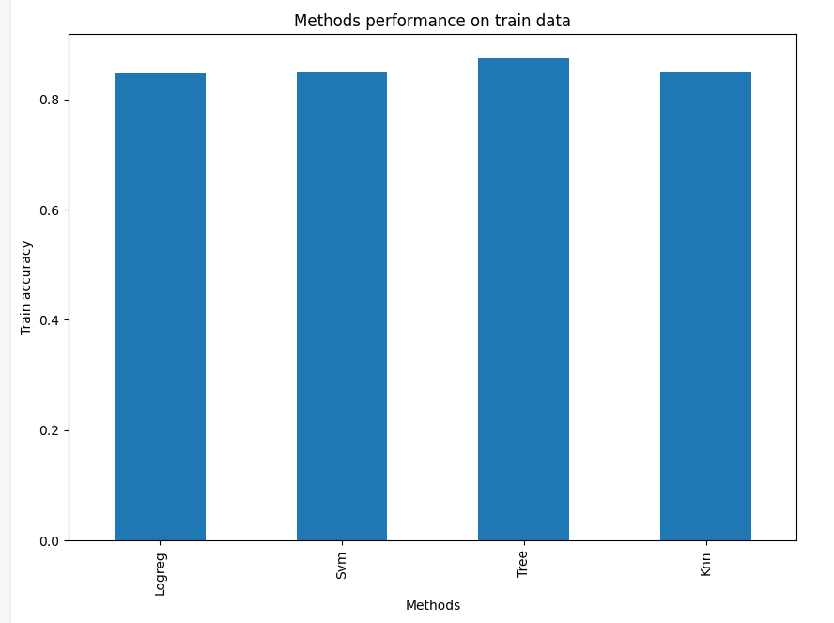
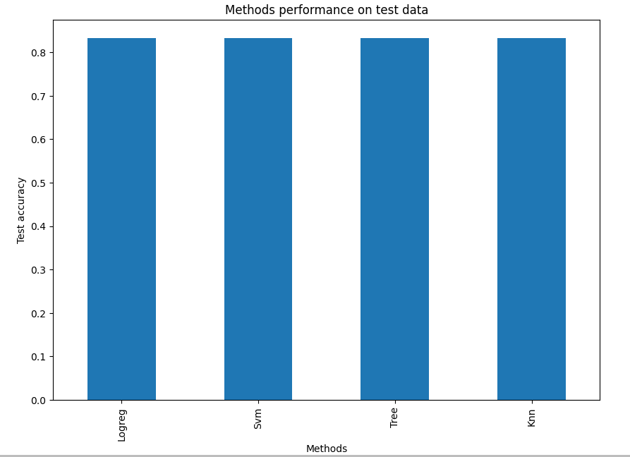
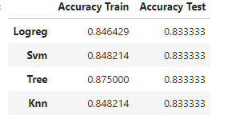
Classification Accuracy
All methods performed roughly the same. Performance on test set was the same

Slide 44
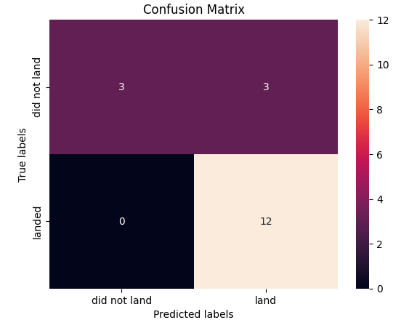
Confusion Matrix
Confusion matrix for the logistic regression

Slide 45
Conclusions
Mission Success Factors: Success of a mission relies on multiple factors such as launch site, orbit, and the cumulative knowledge gained from prior launches. The accumulation of knowledge from past missions likely contributes to the transition from launch failures to successful missions.
Successful Orbits: Orbits with notably high success rates include GEO (Geostationary Earth Orbit), HEO (Highly Elliptical Orbit), SSO (Sun-Synchronous Orbit), and ES-L1 (Earth-Sun L1 Lagrange Point).
Payload Considerations: Payload mass is a critical factor depending on the orbit. Different orbits might require light or heavy payloads. Generally, missions with lower-weighted payloads tend to have better success rates compared to heavier payloads.
Unexplained Success of Launch Sites: Certain launch sites, particularly KSC LC-39A, exhibit higher success rates without clear explanations. Obtaining additional atmospheric or relevant data could provide insights into these success rates.
Model Selection for Dataset: All models performed the same with Logistic regression performing slightly better on training set.

Slide 46
Appendix
The notebooks for this assignment are in:

Slide 47


